Slide 1

Notes:
Open with the title and one line: we want to keep Stonebridge members running all season. Everything that follows is a proposal for the board to shape, not a finished deal.
Concept demo by YourFirstAI — fictional business.
Fonts used: Instrument Serif and Schibsted Grotesk (free on Google Fonts).

Slide 2
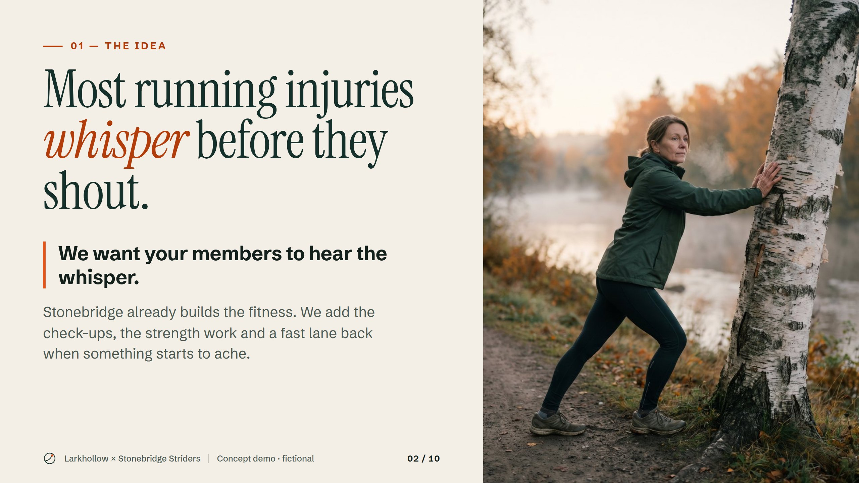
Notes:
Most runners feel a small warning sign weeks before an injury stops them. Our pitch is simple: help members catch it early, while it is still a quick fix.
Concept demo by YourFirstAI — fictional business.

Slide 3
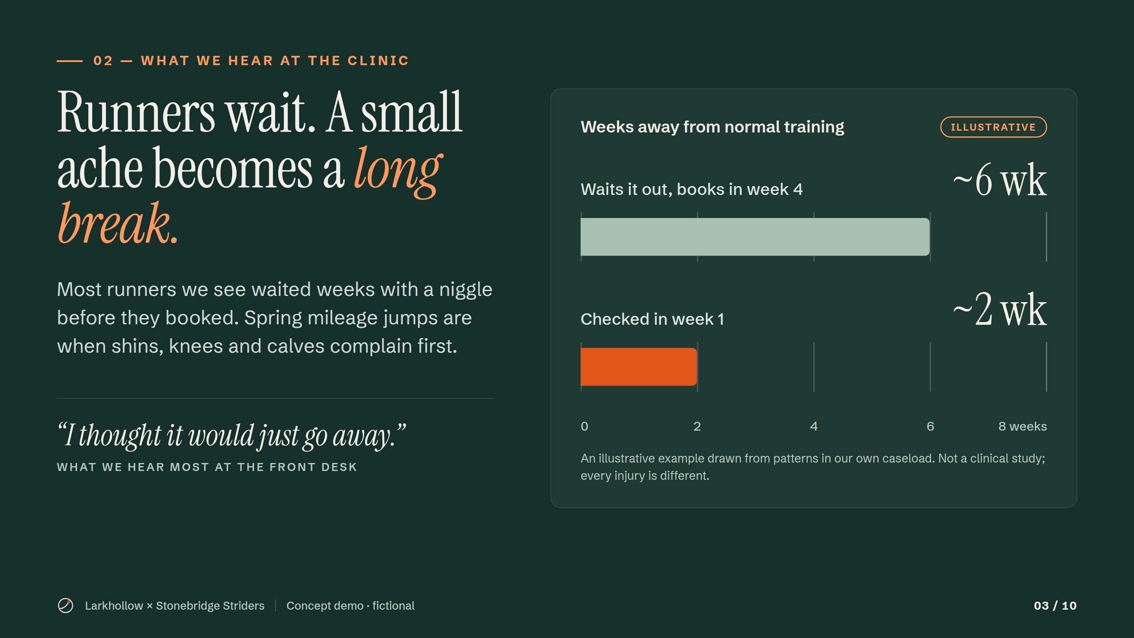
Notes:
The pattern we see at the clinic: runners wait a few weeks before booking, and a small ache turns into a long break. The chart is an illustrative example, not a study, and it shows the gap this partnership is meant to close.
Concept demo by YourFirstAI — fictional business.

Slide 4
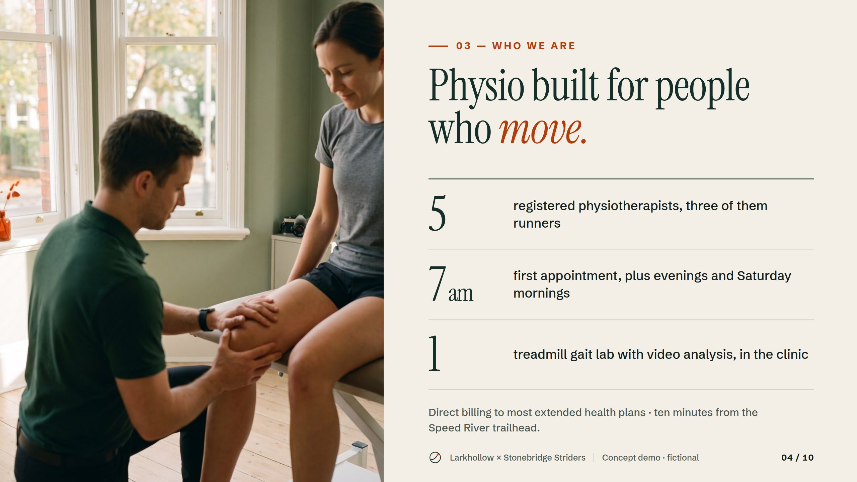
Notes:
A short introduction: five physiotherapists, three of them runners, early and evening hours, and a gait lab in the clinic. We are ten minutes from the trailhead the club already uses.
Concept demo by YourFirstAI — fictional business.

Slide 5
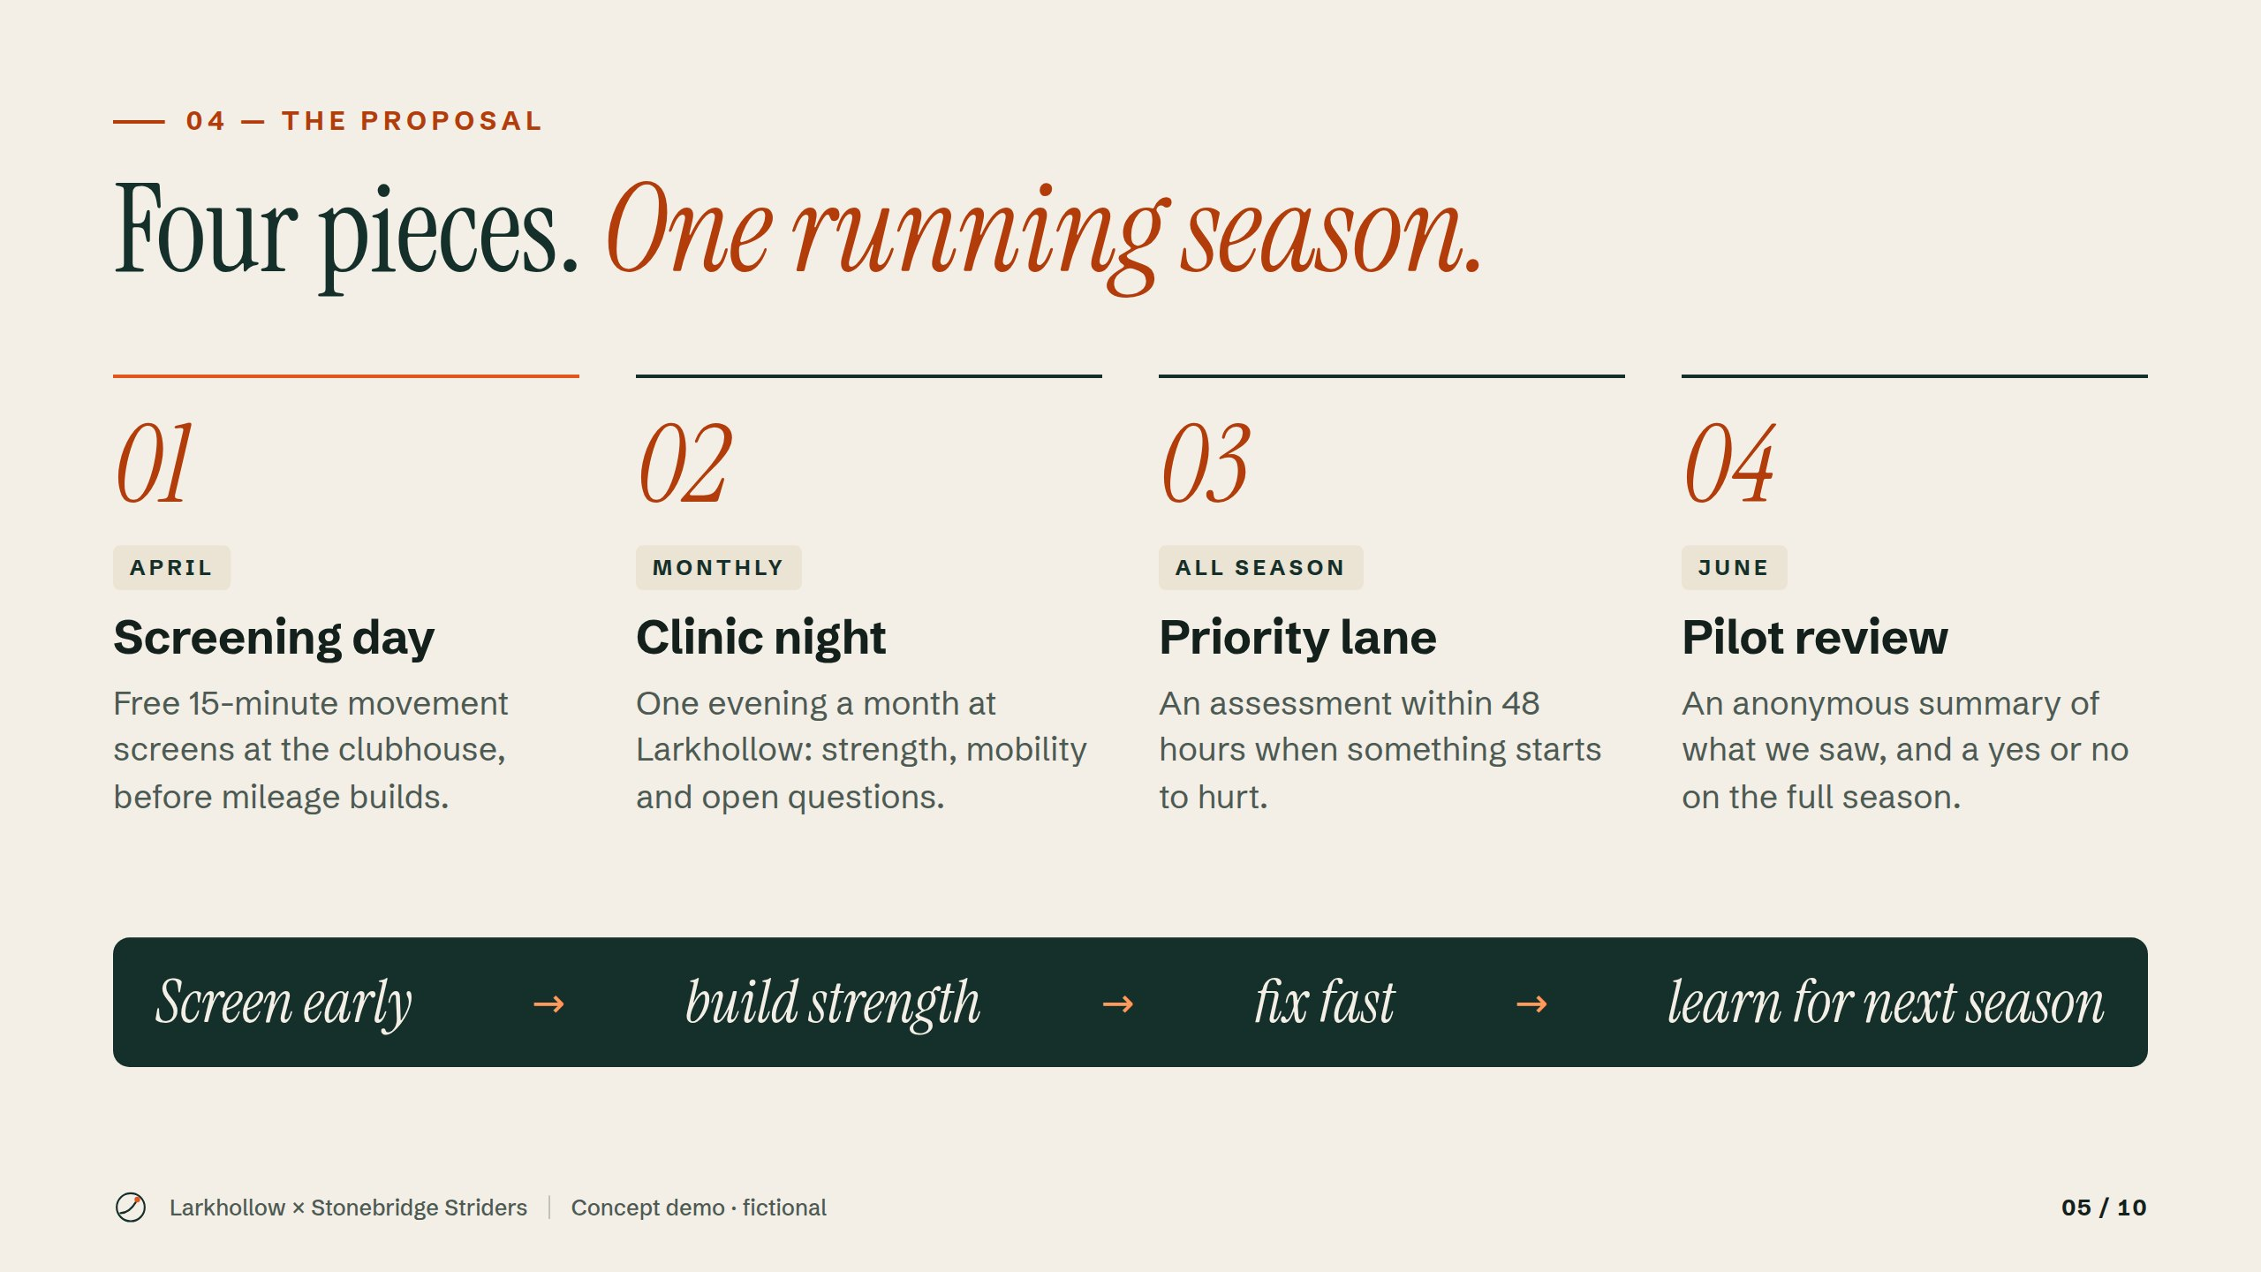
Notes:
Four pieces across one running season: a free screening day in April, a monthly clinic night, a priority lane with appointments within 48 hours, and a short, anonymous review with the board at the end of the pilot.
Concept demo by YourFirstAI — fictional business.

Slide 6
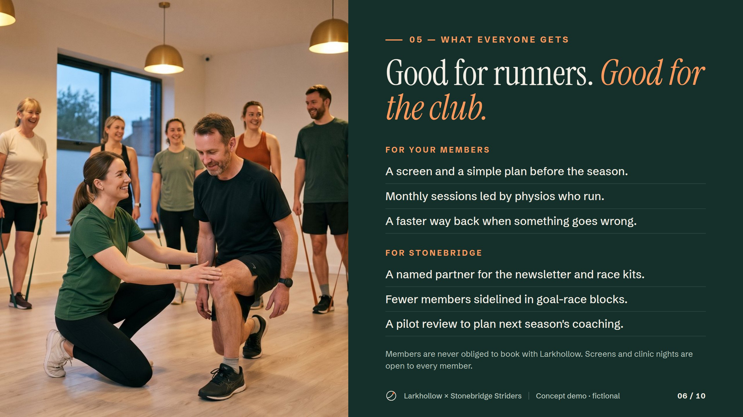
Notes:
Members get a screen, a plan and a faster way back. The club gets a named partner, fewer members sidelined in race blocks, and a review to plan next season. Nobody is ever obliged to book with us.
Concept demo by YourFirstAI — fictional business.

Slide 7
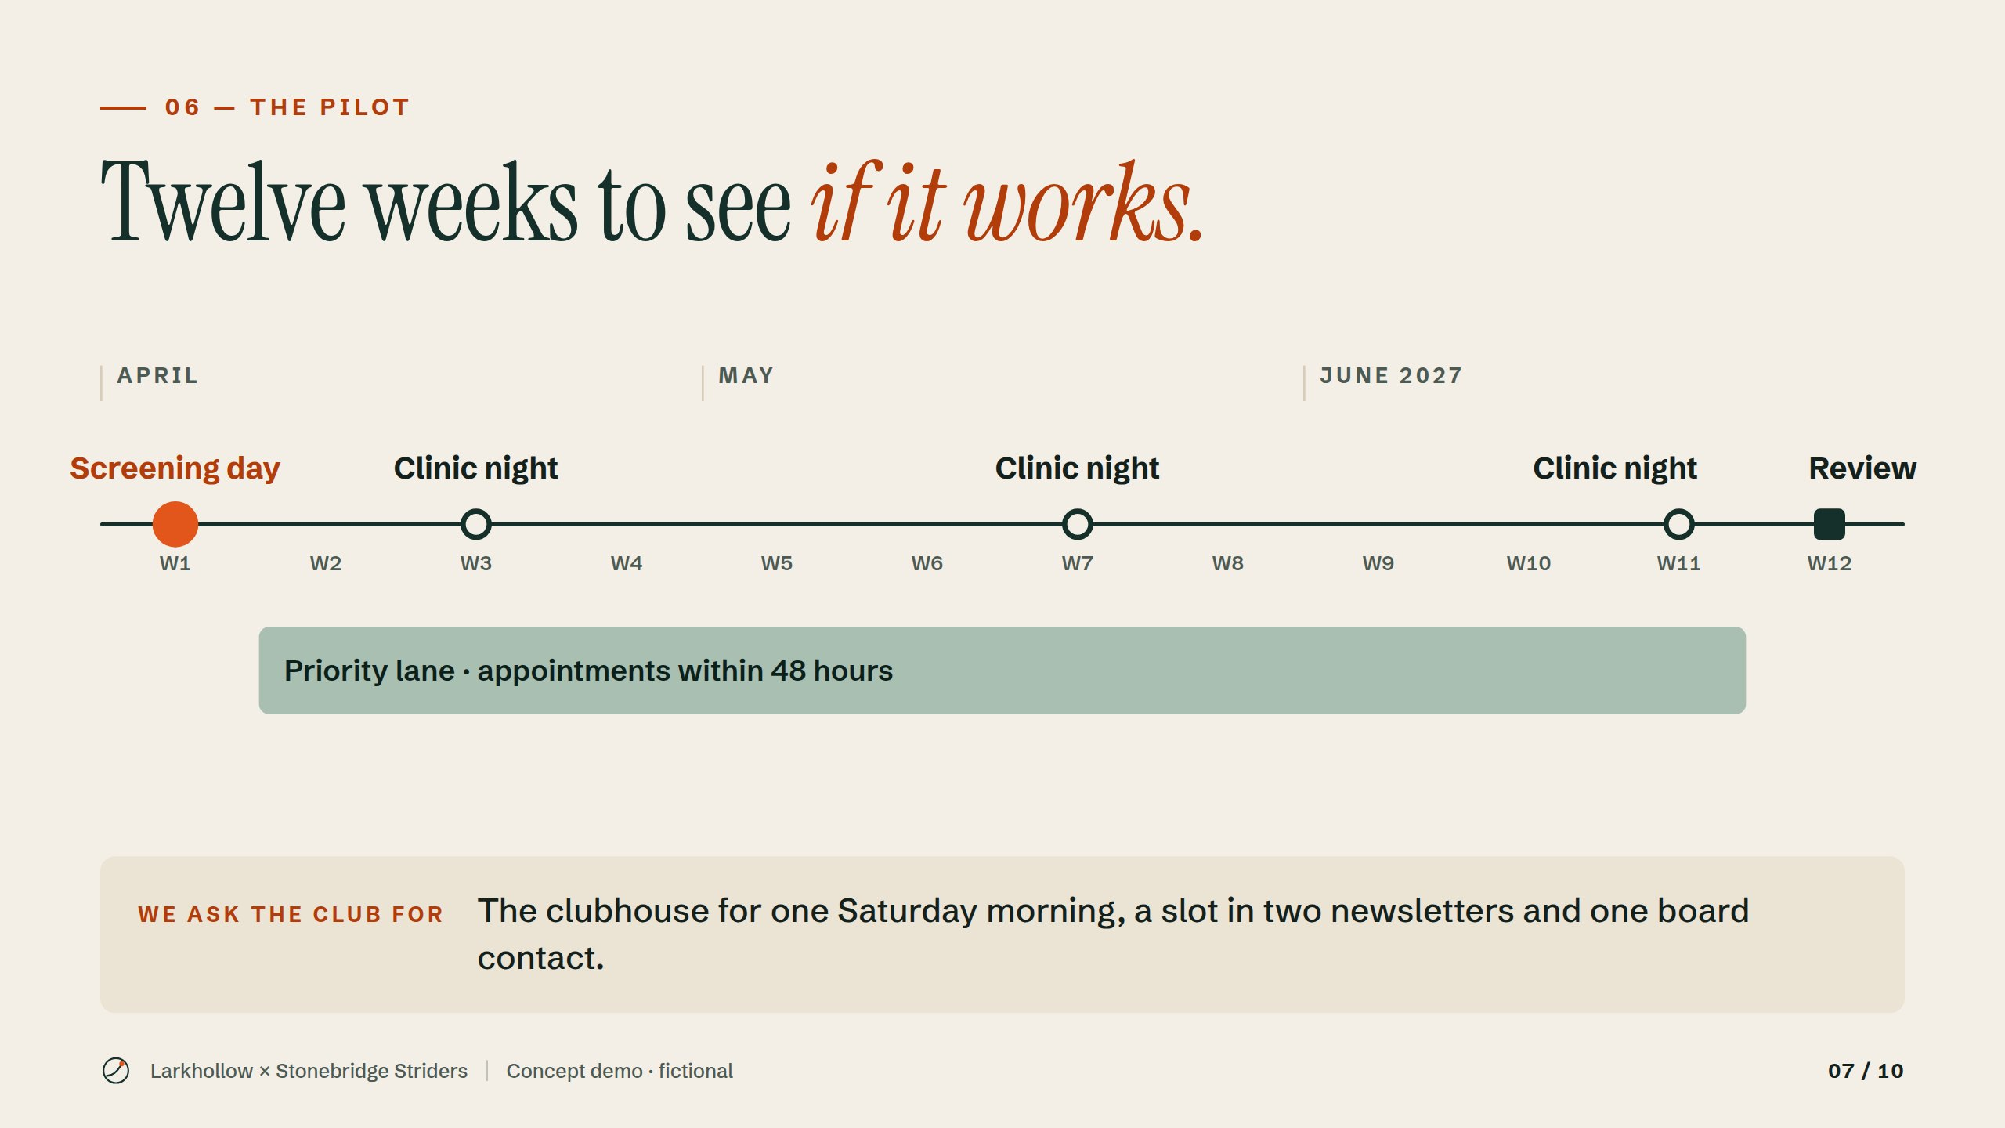
Notes:
Before committing to a full season, we propose a twelve-week pilot from April to June. It opens with the screening day, runs a clinic night each month and the priority lane, and closes with a review with the board. What we need from the club is small.
Concept demo by YourFirstAI — fictional business.

Slide 8
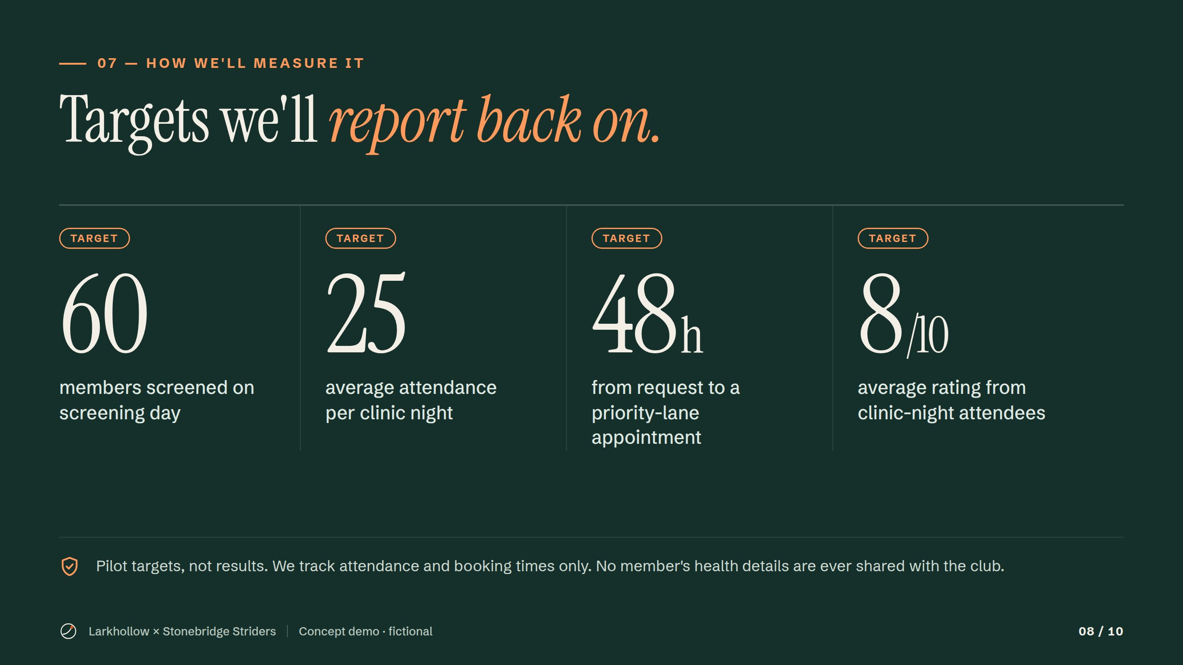
Notes:
Four targets we will report back on at the pilot review in week 12. They are goals, not results. We only track attendance and booking times, and no member's health details are ever shared with the club.
Concept demo by YourFirstAI — fictional business.

Slide 9
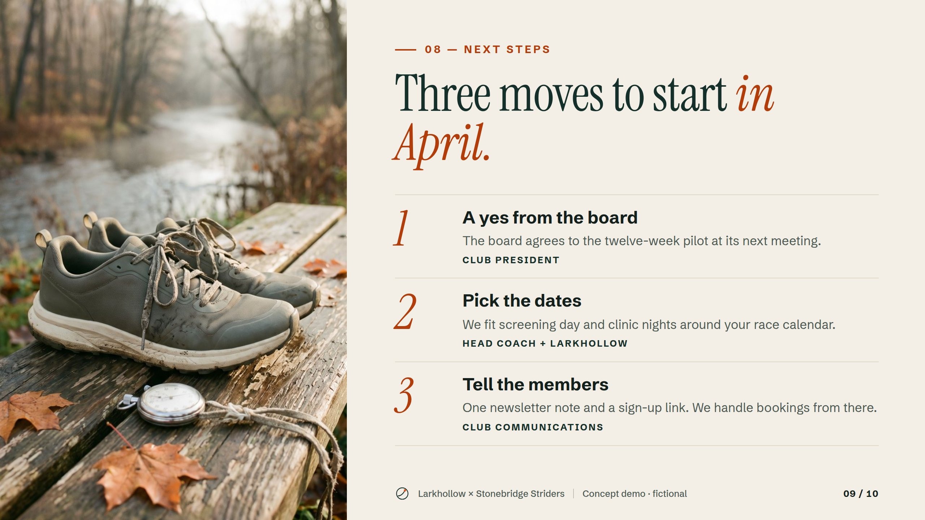
Notes:
Three moves to start in April: a yes from the board, dates that fit the race calendar, and one note to members. We handle bookings from there.
Concept demo by YourFirstAI — fictional business.

Slide 10
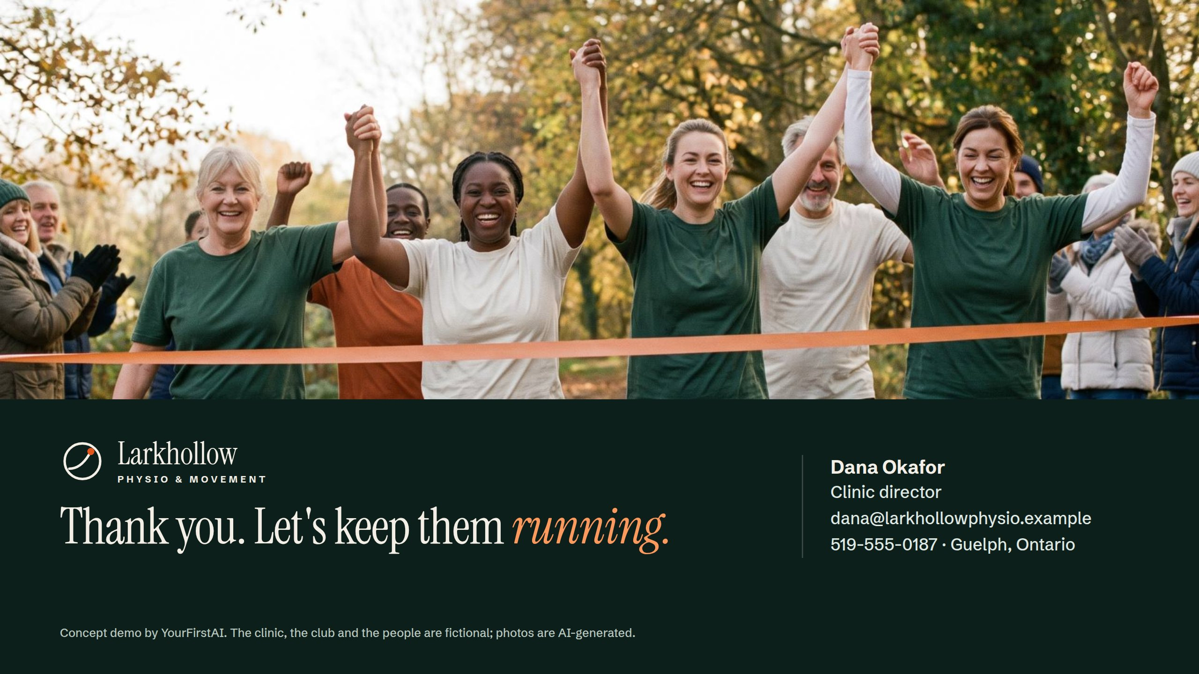
Notes:
Close on the promise and leave the contact on screen. Invite questions from the board.
Concept demo by YourFirstAI — fictional business.

